Slide 1
Data Mining and Statistical Learning
Local Smoothers and Additive Models
Professor Yajun Mei
School of Industrial and Systems Engineering
Lesson 9: Optimality and Algorithm in Splines

Slide 2
Learning Objectives
Explain the optimality properties of natural cubic spline in the interpolating context
Develop efficient algorithm for cubic spline in the smoothing context

Slide 3
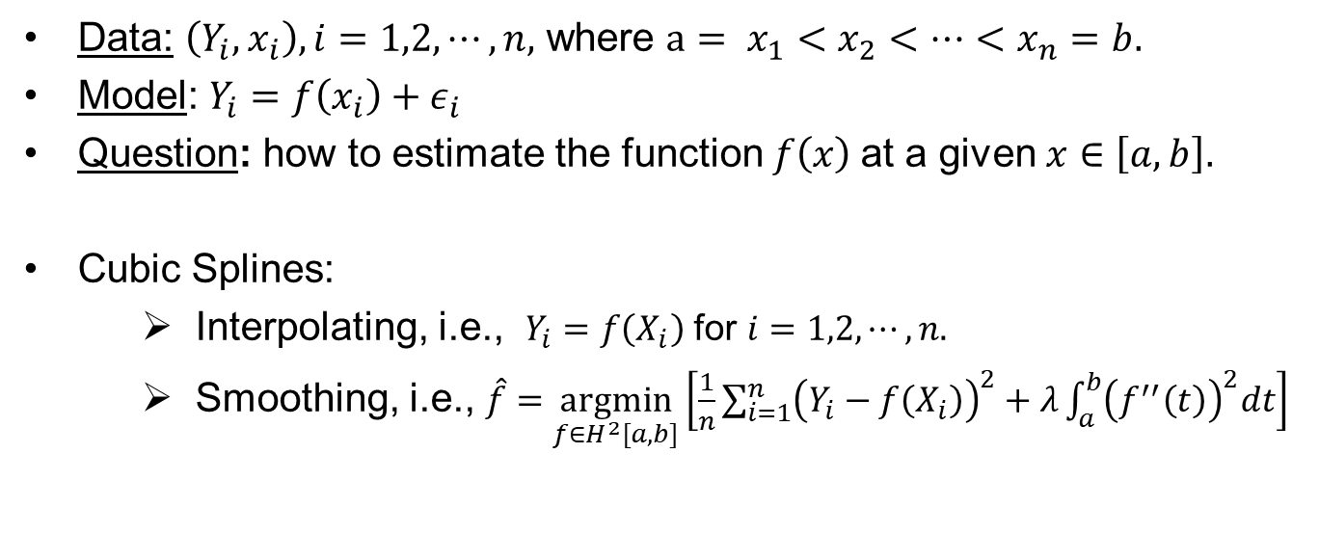
Cubic Splines
Data: $\left(Y_{i},x_{i}\right), i=1,2,⋯,n,$ where $a= x_{1}<x_{2}<⋯<x_{n}=b.$
Model: $Y_{i}=f\left(x_{i}\right)+ε_{i}$
Question: how to estimate the function $f\left(x\right)$at a given $x∈\left[a,b\right].$
Cubic Splines:
Interpolating, i.e., $Y_{i}=f\left(X_{i}\right)$ for $i=1,2,⋯,n.$
Smoothing, i.e., $\hat{f}=\underset{f∈H^{2}[a,b]}{argmin}\left[\frac{1}{n}\sum_{i=1}^{n}{{\left(Y_{i}−f\left(X_{i}\right)\right)}^{2}}+λ\int_{a}^{b}{{\left(f^{′′}\left(t\right)\right)}^{2}dt}\right]$

Slide 4
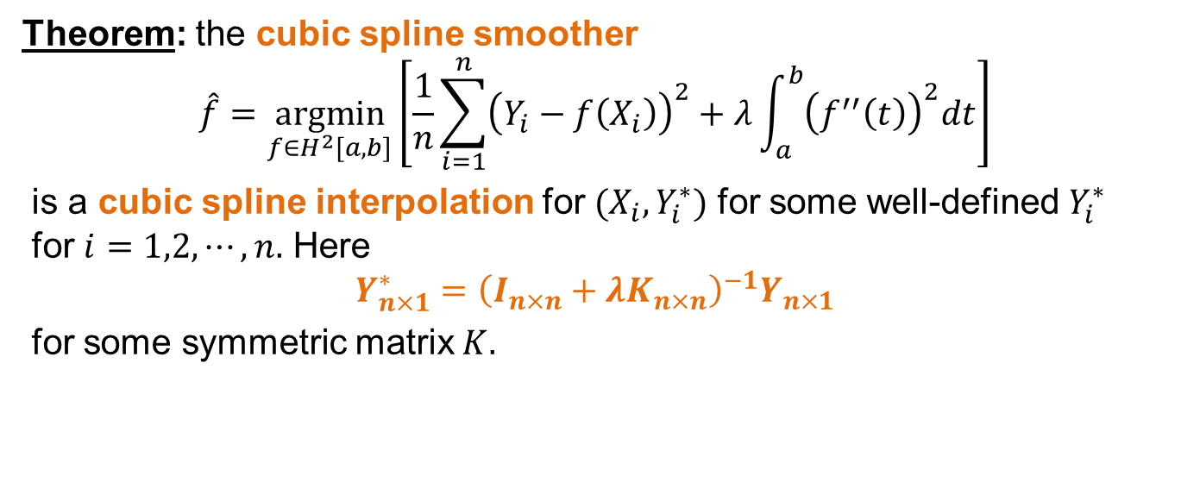
Relation of Cubic Splines
Theorem: the cubic spline smoother
$$\hat{f}=\underset{f∈H^{2}[a,b]}{argmin}\left[\frac{1}{n}\sum_{i=1}^{n}{{\left(Y_{i}−f\left(X_{i}\right)\right)}^{2}}+λ\int_{a}^{b}{{\left(f^{′′}\left(t\right)\right)}^{2}dt}\right]$$
is a cubic spline interpolation for $(X_{i}, Y_{i}^{∗})$ for some well-defined $Y_{i}^{∗}$ for $i=1,2,⋯,n.$ Here $$Y_{n×1}^{∗}={\left(I_{n×n}+λK_{n×n}\right)}^{−1}Y_{n×1}$$
for some symmetric matrix $K.$

Slide 5
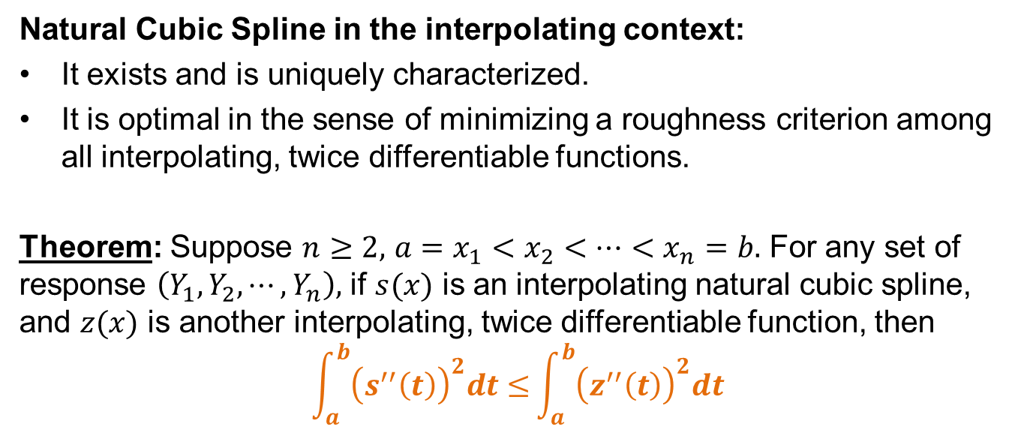
Optimality Properties
Natural Cubic Spline in the interpolating context:
It exists and is uniquely characterized.
It is optimal in the sense of minimizing a roughness criterion among all interpolating, twice differentiable functions.
Theorem: Suppose $n≥2,$ $a=x_{1}<x_{2}<⋯<x_{n}=b.$ For any set of response $\left(Y_{1},Y_{2},⋯, Y_{n}\right),$ if $s(x)$ is an interpolating natural cubic spline, and $z(x)$ is another interpolating, twice differentiable function, then $$\int_{a}^{b}{{\left(s^{′′}\left(t\right)\right)}^{2}dt≤}\int_{a}^{b}{{\left(z^{′′}\left(t\right)\right)}^{2}dt}$$

Slide 6
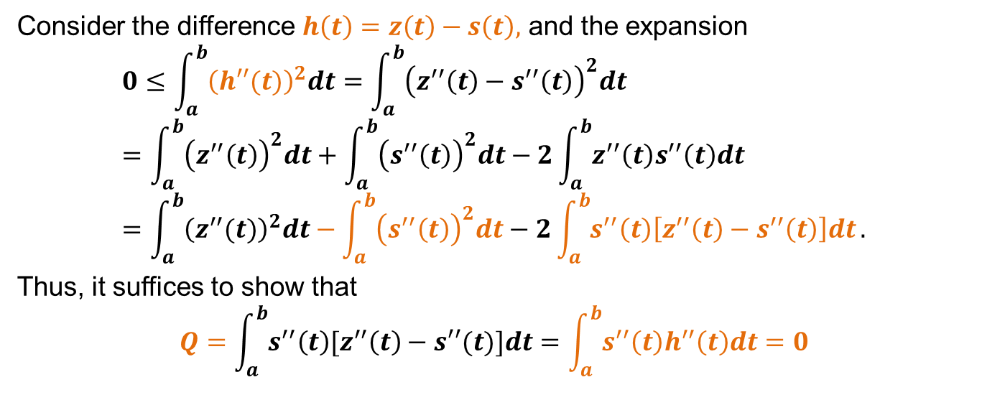
Proof
Consider the difference $h\left(t\right)=z\left(t\right)−s\left(t\right),$ and the expansion
$$0≤\int_{a}^{b}{{\left(h′′(t)\right)}^{2}dt}=\int_{a}^{b}{{\left(z^{′′}\left(t\right)−s^{′′}\left(t\right)\right)}^{2}dt} \\ =\int_{a}^{b}{{\left(z^{′′}\left(t\right)\right)}^{2}dt}+\int_{a}^{b}{{\left(s^{′′}\left(t\right)\right)}^{2}dt}−2\int_{a}^{b}{z^{′′}\left(t\right)s^{′′}\left(t\right)dt}=\int_{a}^{b}{{\left(z^{′′}(t)\right)}^{2}dt}−\int_{a}^{b}{{\left(s^{′′}\left(t\right)\right)}^{2}dt}−2\int_{a}^{b}{s^{′′}\left(t\right)\left[z^{′′}\left(t\right)−s^{′′}\left(t\right)\right]dt}.$$
Thus, it suffices to show that
$$Q=\int_{a}^{b}{s^{′′}\left(t\right)[z^{′′}\left(t\right)−s′′(t)]dt}=\int_{a}^{b}{s^{′′}\left(t\right)h^{′′}\left(t\right)dt}=0$$

Slide 7
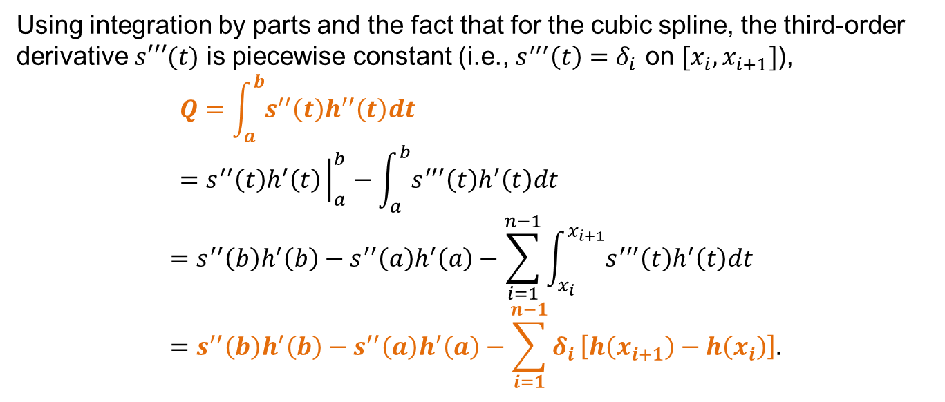
Proof (cont.)
Using integration by parts and the fact that for the cubic spline, the third-order derivative $s′′′(t)$ is piecewise constant (i.e., $s^{′′′}\left(t\right)=δ_{i}$ on $[x_{i}, x_{i+1}]$),
$$Q=\int_{a}^{b}{s^{′′}\left(t\right)h^{′′}\left(t\right)dt}=s^{′′}\left(t\right)h^{′}\left(t\right){\left.​\right|}_{a}^{b}−\int_{a}^{b}{s^{′′′}\left(t\right)h^{′}\left(t\right)dt}$$
$$=s^{′′}\left(b\right)h^{′}\left(b\right)−s^{′′}\left(a\right)h^{′}\left(a\right)−\sum_{i=1}^{n−1}{\int_{x_{i}}^{x_{i+1}}{s^{′′′}\left(t\right)h^{′}\left(t\right)dt}}=s^{′′}\left(b\right)h^{′}\left(b\right)−s^{′′}\left(a\right)h^{′}\left(a\right)−\sum_{i=1}^{n−1}{δ_{i}}\left[h\left(x_{i+1}\right)−h\left(x_{i}\right)\right].$$

Slide 8
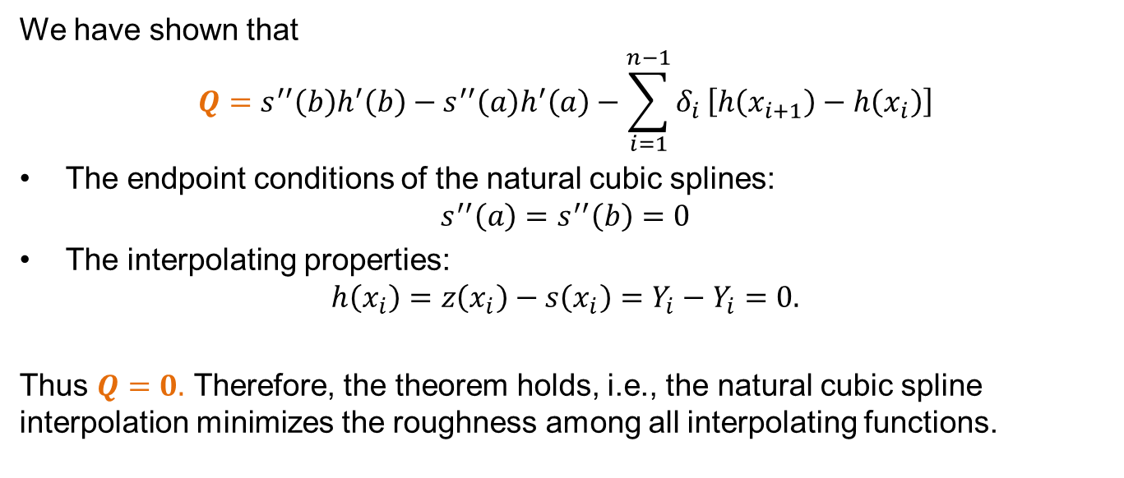
Proof (cont.)
We have shown that
$$Q=s^{′′}\left(b\right)h^{′}\left(b\right)−s^{′′}\left(a\right)h^{′}\left(a\right)−\sum_{i=1}^{n−1}{δ_{i}}\left[h\left(x_{i+1}\right)−h\left(x_{i}\right)\right]$$
The endpoint conditions of the natural cubic splines: $s^{′′}\left(a\right)=s^{′′}\left(b\right)=0$
The interpolating properties: $h\left(x_{i}\right)=z\left(x_{i}\right)−s\left(x_{i}\right)=Y_{i}−Y_{i}=0.$
Thus $Q=0.$ Therefore, the theorem holds, i.e., the natural cubic spline interpolation minimizes the roughness among all interpolating functions.

Slide 9
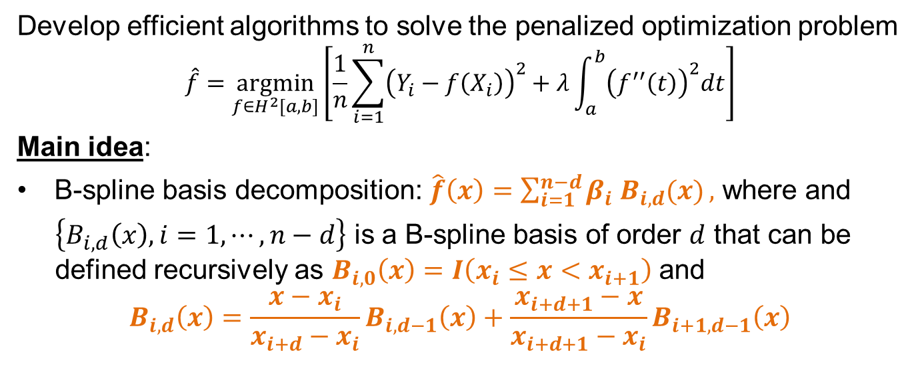
Algorithm for Cubic Splines
Develop efficient algorithms to solve the penalized optimization problem
$$\hat{f}=\underset{f∈H^{2}[a,b]}{argmin}\left[\frac{1}{n}\sum_{i=1}^{n}{{\left(Y_{i}−f\left(X_{i}\right)\right)}^{2}}+λ\int_{a}^{b}{{\left(f^{′′}\left(t\right)\right)}^{2}dt}\right]$$
Main idea:
B-spline basis decomposition: $\hat{f}\left(x\right)=\sum_{i=1}^{n−d}{β_{i} B_{i,d}(x)},$ where and
$\left\{B_{i,d}\left(x\right), i=1, ⋯, n−d\right\}$ is a B-spline basis of order $d$ that can be defined recursively as $B_{i,0}\left(x\right)=I\left(x_{i}≤x<x_{i+1}\right)$ and
$$B_{i,d}\left(x\right)=\frac{x−x_{i}}{x_{i+d}−x_{i}}B_{i, d−1}\left(x\right)+\frac{x_{i+d+1}−x}{x_{i+d+1}−x_{i}}B_{i+1, d−1}\left(x\right)$$

Slide 10
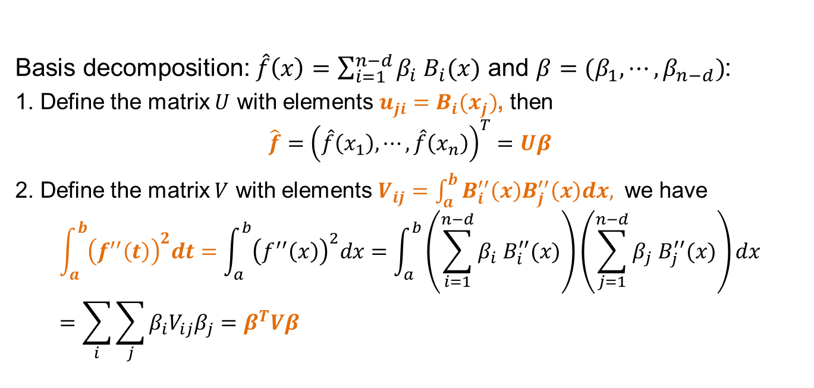
Two Useful Facts
Basis decomposition: $\hat{f}\left(x\right)=\sum_{i=1}^{n−d}{β_{i} B_{i}(x)}$ and $β=(β_{1}, ⋯, β_{n−d})$:
1. Define the matrix $U$ with elements $u_{ji}=B_{i}(x_{j})$, then
$$\hat{f}={\left(\hat{f}\left(x_{1}\right), ⋯, \hat{f}\left(x_{n}\right)\right)}^{T}=Uβ$$
2. Define the matrix $V$ with elements $V_{ij}=\int_{a}^{b}{B_{i}^{′′}\left(x\right)B_{j}^{′′}\left(x\right)dx, }$ we have
$$\int_{a}^{b}{{\left(f^{′′}\left(t\right)\right)}^{2}dt}=\int_{a}^{b}{{\left(f^{′′}\left(x\right)\right)}^{2}dx}=\int_{a}^{b}{\left(\sum_{i=1}^{n−d}{β_{i} B_{i}^{′′}(x)}\right)}\left(\sum_{j=1}^{n−d}{β_{j} B_{j}^{′′}(x)}\right)dx \\ =\sum_{i}{\sum_{j}{β_{i}{V_{ij}β}_{j}}=β^{T}Vβ}$$

Slide 11
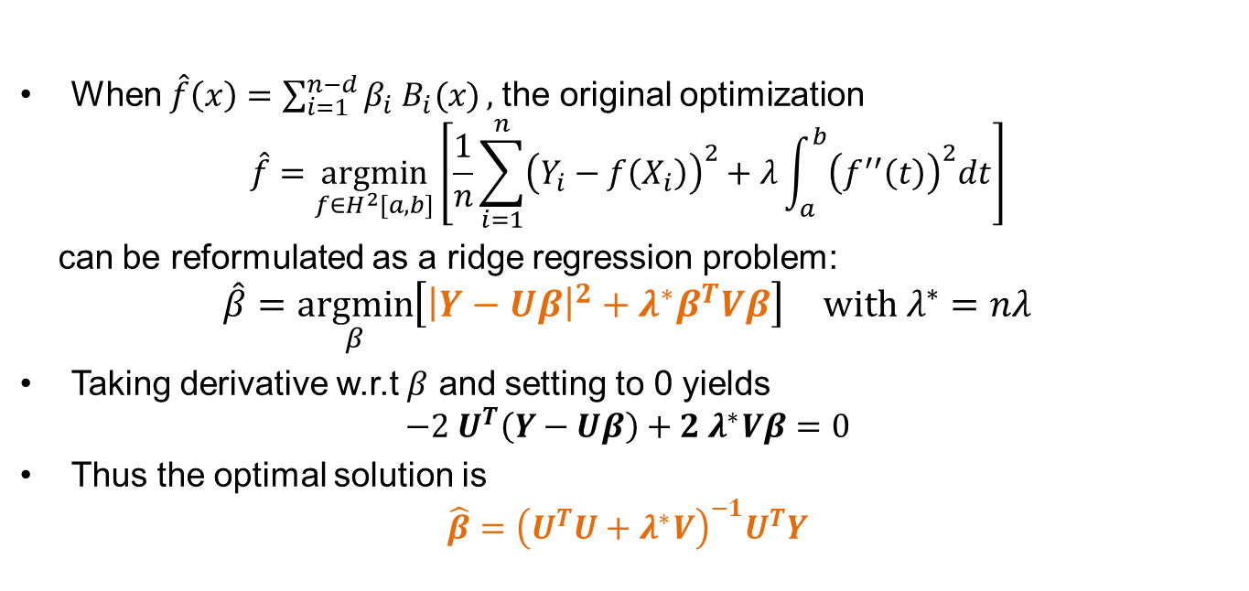
Ridge Regression Approach
When $\hat{f}\left(x\right)=\sum_{i=1}^{n−d}{β_{i} B_{i}(x)},$the original optimization $\hat{f}=\underset{f∈H^{2}[a,b]}{argmin}\left[\frac{1}{n}\sum_{i=1}^{n}{{\left(Y_{i}−f\left(X_{i}\right)\right)}^{2}}+λ\int_{a}^{b}{{\left(f^{′′}\left(t\right)\right)}^{2}dt}\right]$
can be reformulated as a ridge regression problem:
$$\hat{β}=\underset{β}{argmin}\left[{\left|Y−Uβ\right|}^{2}+λ^{∗}β^{T}Vβ\right] with λ^{∗}=nλ$$
Taking derivative w.r.t $β$ and setting to 0 yields $−2 U^{T}\left(Y−Uβ\right)+2 λ^{∗}Vβ=0$
Thus the optimal solution is $\hat{β}={\left(U^{T}U+λ^{∗}V\right)}^{−1}U^{T}Y$

Slide 12
Summary
Relationship between interpolation and smoother for cubic splines
Optimality of natural cubic splines in the interpolating context
Efficient algorithm for cubic splines in the smoothing context

